Slide 1

Unit-1
Introduction to
Data Structure
Data Structure (DS)
DU# 2305CS201
Prof. Shruti Maniar
Computer Engineering Department
shruti.maniar@darshan.ac.in

Slide 2

Looping
Outline
  Data Management concepts
  Data types
    Primitive
    Non-primitive
  Types of Data Structures
    Linear Data Structures
    Non Linear Data Structures
  Performance Analysis and Measurement
  Time analysis of algorithms
  Space analysis of algorithms

Slide 3

What is Data?
Data is the basic fact or entity that is utilized in calculation or manipulation.
There are two different types of data Numeric data and Alphanumeric data.
When a programmer collects such type of data for processing, he would require to store them in computer’s main memory.
The process of storing data items in computer’s main memory is called representation.
Data to be processed must be organized in a particular fashion, these organization leads to structuring of data, and hence the mission to study the Data Structures.

Slide 4

What is Data Structure?
A Data Structure is a way of storing and organizing data in to computer memory, so that data can be accessed easily and efficiently.
A Data Structure is a representation of the logical relationship existing between individual elements of data.
A data structure is a way of organizing all data items that considers not only the elements stored but also their relationship to each other.
Data structure can also be defined as a mathematical or logical model of a particular organization of data items.

Slide 5
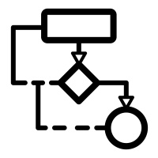

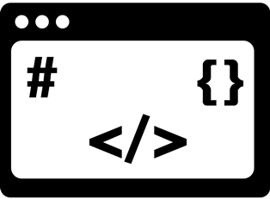
What is Data Structure? Cont..
The representation of a particular data structure in the memory of a computer is called Storage Structure.
Algorithm
Data Structure
Program

Slide 6
Classification of Data Structure
Data Structure
Primitive Data Structure
Non-Primitive Data Structure
Integer
Characters
Arrays
Lists
Files
Floating
Point
Pointers
Linear List
Non-linear List
Stack
Queue
Graphs
Trees

Slide 7
Primitive / Non-primitive data structures
Primitive data structures
  Primitive data structures are basic structures and are directly operated upon by machine instructions.
  Integers, floats, character and pointers are examples of primitive data structures.
Non primitive data structure
  These are derived from primitive data structures.
  The non-primitive data structures emphasize on structuring of a group of homogeneous or heterogeneous data items.
  Examples of Non-primitive data type are Array, List, and File.

Slide 8
Non primitive Data Structure
Array: An array is a fixed-size sequenced collection of elements of the same data type.
List: An ordered set containing variable number of elements is called as Lists.
File: A file is a collection of logically related information. It can be viewed as a large list of records consisting of various fields.
Name | Roll No. | Year | Marks
AMIT | 1000 | 1 | 82
KALPESH | 1005 | 2 | 54
JITENDRA | 1009 | 1 | 75
RAVI | 1010 | 1 | 79
…
…
…
Array
List
File

Slide 9
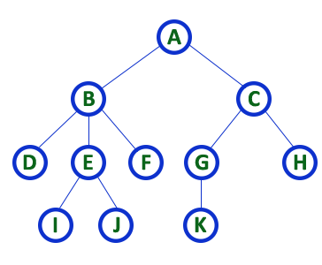
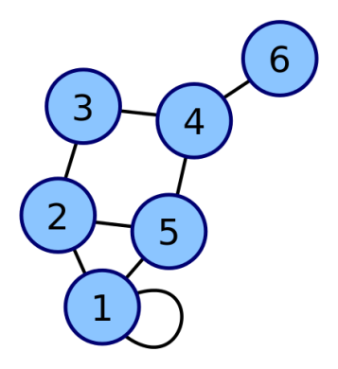
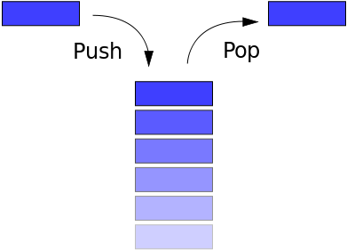
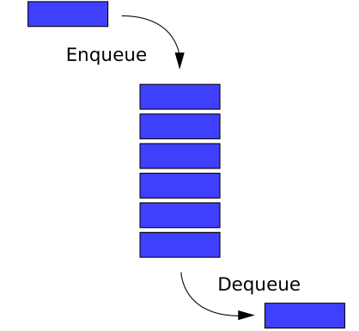
Linear / Non-Linear data structure
Linear data structures
  A data structure is said to be Linear, if its elements are connected in linear fashion by means of logically or in sequence memory locations.
  Examples of Linear Data Structure are Stack and Queue.
Nonlinear data structures
  Nonlinear data structures are those data structure in which data items are not arranged in a sequence.
  Examples of Non-linear Data Structure are Tree and Graph.
Stack
Queue
Tree
Graph

Slide 10
Differences between Linear and Non-Linear Data Structures
Sr.No. | Linear Data Structure | Non-Linear Data Structure
1 | Elements are arranged in a linear order where each and every element is attached to its previous and next adjacent. | Elements are attached in hierarchically manner.
2 | Single level is involved. | Multiple levels are involved.
3 | Its implementation is easy in comparison to non-linear data structure. | Its implementation is complex in comparison to linear data structure.
4 | Data elements can be traversed in a single run only. | Data elements can’t be traversed in a single run only.
5 | Its examples are: array, stack, queue, linked list, etc. | Its examples are: trees and graphs.
6 | Applications of linear data structures are mainly in application software development. | Applications of non-linear data structures are in Artificial Intelligence and image processing.

Slide 11
Operations of Data Structure
Create: It results in reserving memory for program elements.
Destroy: It destroys memory space allocated for specified data structure.
Selection: It deals with accessing a particular data within a data structure.
Updation: It updates or modifies the data in the data structure.
Searching: It finds the presence of desired data item in the list of data items.
Sorting: It is a process of arranging all data items in a data structure in a particular order.
Merging: It is a process of combining the data items of two different sorted list into a single sorted list.
Splitting: It is a process of partitioning single list to multiple list.
Traversal: It is a process of visiting each and every node of a list in systematic manner.

Slide 12
Time and space analysis of algorithms
Sometimes, there are more than one way to solve a problem.
We need to learn how to compare the performance of different algorithms and choose the best one to solve a particular problem.
While analysing an algorithm, we mostly consider time complexity and space complexity.
Time complexity of an algorithm quantifies the amount of time taken by an algorithm to run as a function of the length of the input.
Space complexity of an algorithm quantifies the amount of space or memory taken by an algorithm to run as a function of the length of the input.
Time & space complexity depends on lots of things like hardware, operating system, processors, etc.
However, we don't consider any of these factors while analysing the algorithm. We will only consider the execution time of an algorithm.

Slide 13
Worst-Best-Average Case Time Complexity
Worst-Case Analysis:
  In Worst Case analysis upper bound on the running time of an algorithm is calculated.
  This is the case that causes a maximum number of operations to be executed.
  For Linear Search, the worst case happens when the element to be searched (x) is not present in the array.
  When x is not present, the search() function compares it with all the elements of arr[] one by one.
  Therefore, having the knowledge of worst-case running time gives us an assurance that the algorithm will never go beyond this time limit.

Slide 14
Worst-Best-Average Case Time Complexity
Best-Case Analysis:
  In Best Case analysis lower bound on the running time of an algorithm is calculated.
  This is the case that causes a minimum number of operations to be executed.
  In the Linear Search problem, the best case occurs when x is present at the first location.

Slide 15
Worst-Best-Average Case Time Complexity
Average-Case Analysis:
  In Average Case analysis, we take all possible inputs and calculate the computing time for all of the inputs.
  Sum all the calculated values and divide the sum by the total number of inputs.
  It specifies the expected behavior of the algorithm when the input is randomly drawn from a given distribution.
  For Linear Search, this case happens when the search element is present somewhere in the middle of the array.

Slide 16
Notations in Complexity Analysis of Algorithm
Big-O Notation:
  An algorithm’s worst-case time complexity is defined by the Big-O notation.
  This notation gives the maximum amount of time an algorithm requires to consider all input values.
  Notation used: (O)
Omega Notation:
  An algorithm’s best-case time complexity is defined by the Omega notation.
  This notation gives the minimum amount of time an algorithm requires to consider all input values.
  Notation used: (Ω)
Theta Notation:
  An algorithm’s average-case time complexity is defined by the Theta notation.
  This notation gives the estimated average amount of time an algorithm requires to consider all input values.
  Notation used: (Ꝋ)

Slide 17
Calculate Time Complexity of Algorithm
Time Complexity is most commonly estimated by counting the number of elementary functions performed by the algorithm.
Since the algorithm's performance may vary with different types of input data,
  hence for an algorithm we usually use the worst-case Time complexity of an algorithm because that is the maximum time taken for any input size.

Slide 18
Calculating Time Complexity
Calculate Time Complexity of Sum of elements of List (One dimensional Array)
A is array, n is no of elements in array
SumOfList(A,n)
{
Line 1 total = 0
Line 2 for i = 0 to n-1
Line 3 total = total + A[i]
Line 4 return total
}
Line
Cost
No of Times
1
1
1
2
2
n + 1
3
2
n
4
1
1
TSumOfList = 1 + 2 (n+1) + 2n + 1
= 4n + 4
We can neglate constant 4
= n
Time complexity of given algorithm is n unit time

Slide 19

Data Structure (DS)
DU #2305CS201
Prof. Shruti Maniar
Computer Engineering Department
shruti.maniar@darshan.ac.in

